Slide 1
Machine learning
簡廷因 Ting-Ying Chien
2022.5.12

Slide 2
Outline
Data classification
Estimate

Slide 3
Data classification - KNN

Slide 4
Data Classification
Class Prediction
A classification task usually involves with training and testing data which consist of some data instances.
Each instance in the training set contains one "target value" (class labels) and several "attributes" (features)
Training
dataset
label
features
model
ML/DL
Result
Testing
dataset
label
features
Prediction
Evaluation

Slide 5
Data Classification
Cross validation
The goal of cross validation is to define a dataset to "test" the model in the training phase (i.e., the validation dataset), in order to limit problems like overfitting, give an insight on how the model will generalize to an independent dataset (i.e., an unknown dataset, for instance from a real problem), etc.
One round of cross-validation involves partitioning a sample of data into complementary subsets, performing the analysis on one subset (called the training set), and validating the analysis on the other subset (called the validation set or testing set). To reduce variability, multiple rounds of cross-validation are performed using different partitions, and the validation results are averaged over the rounds.

Slide 6
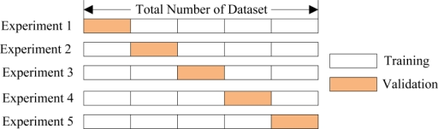
Data Classification
Cross validation

Slide 7
Data Classification
KNN classifiers
k-nearest neighbor algorithm (is a method for classifying objects based on closest training examples in the feature space
Parameter: K

Slide 8
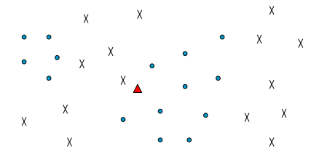
Data Classification
KNN classifiers
K = 1, prediction of "Δ" = "X"
K= 3, prediction of "Δ” = “O"

Slide 9
Data Classification
> install.packages("e1071")
> install.packages("class")
> library(e1071)
> library(class)
> train=read.table("train_data.csv", header=T, sep=",")
> test=read.table("test_data.csv", header=T, sep=",")
> ctrain=scan("ctrain.txt",what=character())
> ctest=scan("ctest.txt",what=character())
> ctrain=as.factor(ctrain)
> ctest=as.factor(ctest)
> tune.knn(train, ctrain, k = 1:5) # best K = 1
> k.result=knn(train, test, ctrain, k=1)
> ctest
[1] L L L L L L L L L L L L L L L L L L L L M M M M M M M M M M M M M M
Levels: L M
> k.result
[1] L L L L L L L L L L L L L L L L L L L L M M M M M M M M M M L M M M
Levels: L M

Slide 10




Estimate
prediction
Actual value
Accuracy=$\frac{TP+TN}{TP+FP+TN+FN}$
FP
TP
FN
Sensitivity =$\frac{TP}{TP+FN}$
TN
Specificity=$\frac{TN}{FP+TN}$
Precision=$\frac{TP}{TP+FP}$
 |  | Actual value
 |  | Positive | Negative
Prediction | Positive | True Positive(TP) | False Positive(FP)
 | Negative | False Negative(FN) | True Negative(TN)

Slide 11
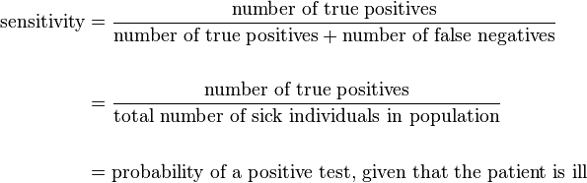
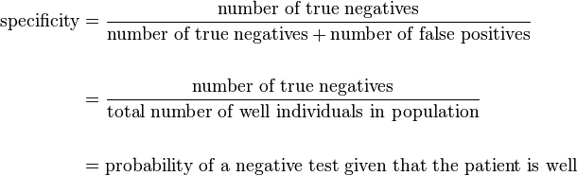
Estimate

Slide 12
Estimate
If #positive : # negative = 1:999 in a dataset
Predictor always predicts "negative"
Accuracy = 0.999
Sensitivity=0
Specificity=1
Precision=0
Predictor always predicts "positive"
Accuracy = 0.001
Sensitivity=1
Specificity=0
Precision=0.001

Slide 13
Exercise
Calculate the TP, FP, TN and FN of the example in p.9
Assume "L" is positive
Calculate the accuracy, sensitivity, specificity and precision of the example in p.9

Slide 14
Exercise
Dataset : iris
Training data : 135 (random)
Testing data:15
Develop a KNN model to predict species.
set.seed(2)
Calculate the accuracy
> set.seed(2) #random seed
> n=0.1*nrow(iris)
> test.index=sample(1:nrow(iris),n)
> iris.train=iris[-test.index,]
> iris.test=iris[test.index,]

Slide 15
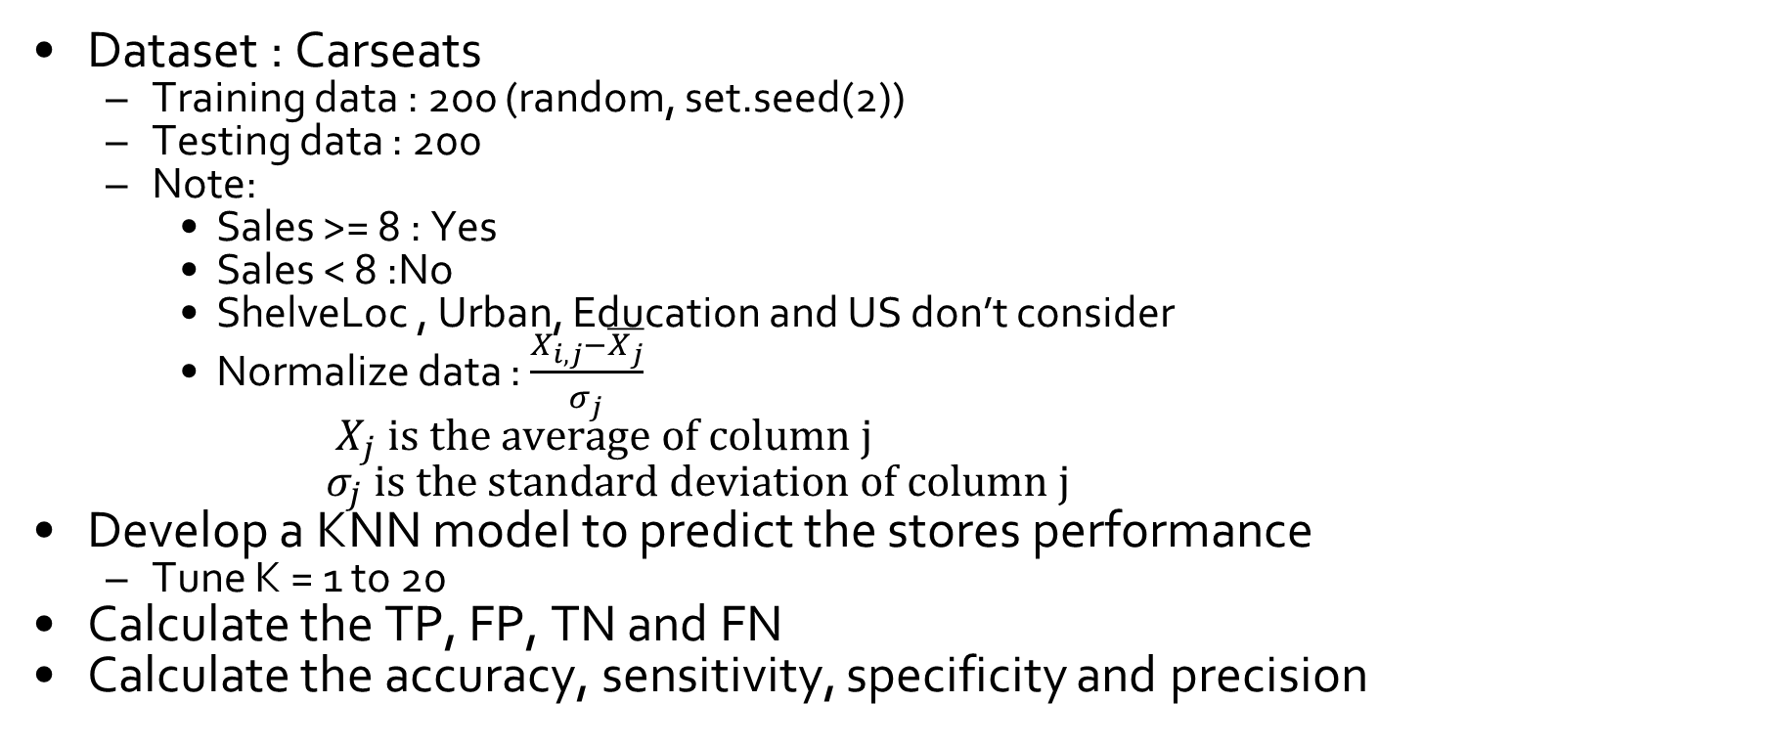
Exercise
Dataset : Carseats
Training data : 200 (random, set.seed(2))
Testing data : 200
Note:
Sales >= 8 : Yes
Sales < 8 :No
ShelveLoc , Urban, Education and US don’t consider
Normalize data : $\frac{X_{i,j}−\overline{X_{j}}}{σ_{j}}$
${ X}_{j} is the average of column j$
$σ_{j} \text{is} \text{the} \text{standard} \text{deviation} \text{of} \text{column} \text{j}$
Develop a KNN model to predict the stores performance
Tune K = 1 to 20
Calculate the TP, FP, TN and FN
Calculate the accuracy, sensitivity, specificity and precision

Slide 16
Data classification – Decision Tree

Slide 17
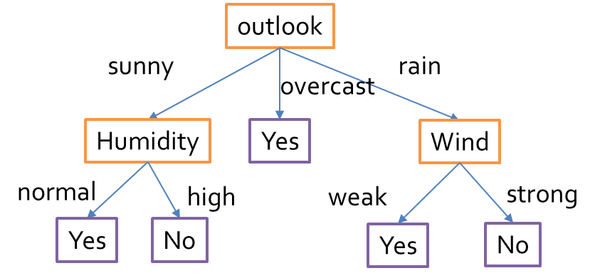
Data classification – Decision Tree
Decision tree learning uses a decision tree as a predictive model which maps observations about an item to conclusions about the item's target value.
Tree models where the target variable can take a finite set of values are called classification trees.

Slide 18
Data classification – Decision Tree
> install.packages("ISLR")
> install.packages("rpart")
> library(ISLR)
> library(rpart)
> high = ifelse (Carseats$Sales >=8,"YES","NO")
> x=cbind(Carseats,high)
> x$Education = as.factor(x$Education)
> y=x[,-1]
> set.seed(2) #set random seed
> train =sample(1:nrow(y),nrow(y)/2) #training data index
> test = -train #testing data index
> train_data=y[train,]
> test_data=y[test,]
> test_high=high[test] #answer
> tree_model=rpart(high~.,data=train_data) #build model
> plot(tree_model)
> text(tree_model)
> tree_predict=predict(tree_model,test_data,type="class")
> tree_predict
> mean(tree_predict==test_high) #accuracy

Slide 19
Exercise
Dataset
train=read.table("train_data.csv", header=T, sep=",")
test=read.table("test_data.csv", header=T, sep=",")
ctrain=scan("ctrain.txt",what=character())
ctest=scan("ctest.txt",what=character())
Develop a decision tree model to predict whether the patient is sick or not.
rpart
Calculate the TP, FP, TN and FN
Calculate the accuracy, sensitivity, specificity and precision

Slide 20
Data classification – Random Forest

Slide 21
Data classification – Random Forest
Random Forests are an ensemble learning method for classification and regression that construct a number of decision trees at training time and outputting the class that is the mode of the classes output by individual trees.

Slide 22
Data classification – Random Forest
Algorithm
Assume
N : #cases in training dataset
M : # of feature
Step1: A different subset of the training data are selected (~2/3), but with replacement
Step2: a number m<<M is specified such that at each node, m variables are selected at random out of the M and the best split on these m is used to split the node. The value of m is held constant during the forest growing
Each tree is grown to the largest extent possible. There is no pruning.
Class assignment is made by the number of votes from all of the trees and for regression the average of the results is used

Slide 23
Data classification – Random Forest
> install.packages("randomForest")
> library(randomForest)
> set.seed(2)
> n=0.1*nrow(iris)
> test.index=sample(1:nrow(iris),n)
> iris.train=iris[-test.index,]
> iris.test=iris[test.index,]
> iris.rf=randomForest(Species~.,data=iris.train)
> rf.pred=predict(iris.rf,newdata=iris.test)
> rf.pred

Slide 24
Data classification – Random Forest
> install.packages("randomForest")
> install.packages("ISLR")
> library(randomForest)
> library(ISLR)
> high = ifelse (Carseats$Sales >=8,"YES","NO")
> x=cbind(Carseats,high)
> x$Education = as.factor(x$Education)
> x$high = as.factor(x$high)
> y=x[,-1]
> set.seed(2) #set random seed
> train =sample(1:nrow(y),nrow(y)/2) #training data index
> test = -train #testing data index
> train_data=y[train,]
> test_data=y[test,]
> test_high=high[test] #answer
> tree_model=randomForest(high~.,data=train_data) #build model
> rf.predict=predict(tree_model,test_data,type="class")
> rf.predict
> mean(rf.predict==test_high)

Slide 25
Exercise
Dataset
train=read.table("train_data.csv", header=T, sep=",")
test=read.table("test_data.csv", header=T, sep=",")
ctrain=scan("ctrain.txt",what=character())
ctest=scan("ctest.txt",what=character())
Develop a random forest model to predict whether the patient is sick or not.
set.seed(100)
Calculate the TP, FP, TN and FN
Calculate the accuracy, sensitivity, specificity and precision

Slide 26
Data classification – Native Bayes

Slide 27


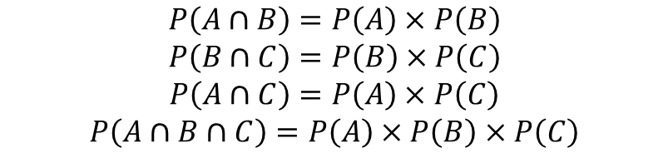
Data classification – Naïve Bayes
Conditional probability
Independence
Two events
Three events
$$P\left(A | B\right)=\frac{P(A∩B)}{P(B)}$$
$$P(A∩B)=P(A)×P(B)$$
$$P\left(A∩B\right)=P\left(A\right)×P\left(B\right)$$
$$P\left(B∩C\right)=P\left(B\right)×P\left(C\right)$$
$$P\left(A∩C\right)=P\left(A\right)×P\left(C\right)$$
$$P\left(A∩B∩C\right)=P\left(A\right)×P\left(B\right)×P\left(C\right)$$

Slide 28
Data classification – Naïve Bayes
Conditionally Independent
two events A and B are conditionally independent given a third event C precisely if the occurrence or non-occurrence of A and the occurrence or non-occurrence of B are independent events in their conditional probability distribution given C.
$$P(A∩B|C)=P(A|C)×P(B|C)$$

Slide 29


Data classification – Naïve Bayes
Partition
H₁, H₂, H₃ ,… H_{n} are subsets of space S that satisfy
$$H_{1}∪H_{2}∪H_{3}∪…∪H_{n}=S$$
$$H_{i}∩H_{j}=∅,∀i≠j$$
S
H1
Hn
H2
H3
…

Slide 30
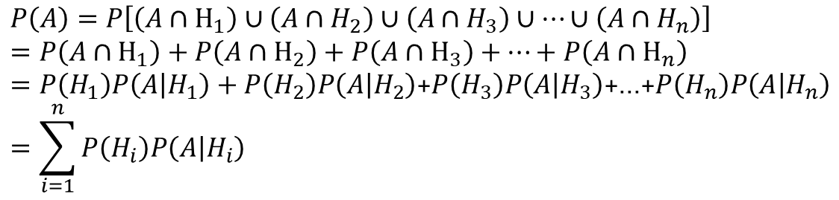
Data classification – Naïve Bayes
Partition
Event A ⊂ S ,
$$P\left(A\right)=P\left[\left(A∩H_{1}\right)∪\left(A∩H_{2}\right)∪\left(A∩H_{3}\right)∪…∪\left(A∩H_{n}\right)\right]$$
$$=P\left(A∩H_{1}\right)+P\left(A∩H_{2}\right)+P\left(A∩H_{3}\right)+…+P\left(A∩H_{n}\right)$$
$=P\left(H_{1}\right)P\left(A | H_{1}\right)+P\left(H_{2}\right)P\left(A | H_{2}\right)$+$P\left(H_{3}\right)P\left(A | H_{3}\right)$+…+$P\left(H_{n}\right)P\left(A | H_{n}\right)$
$$=\sum_{i=1}^{n}{P\left(H_{i}\right)P\left(A | H_{i}\right)}$$
S
A
H1
Hn
H2
H3
…

Slide 31
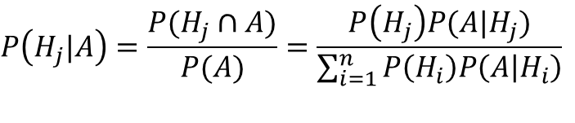
Data classification – Naïve Bayes
Bayes’ Theorem
$$P\left(H_{j}|A\right)=\frac{P(H_{j}∩A)}{P(A)}=\frac{P\left(H_{j}\right)P(A|H_{j})}{\sum_{i=1}^{n}{P\left(H_{i}\right)P\left(A | H_{i}\right)}}$$
S
A
H1
Hn
H2
H3
…

Slide 32
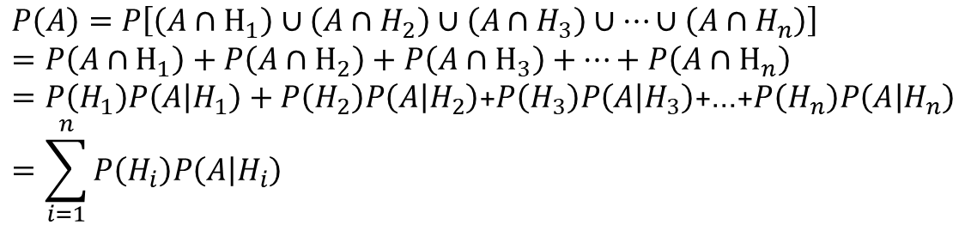
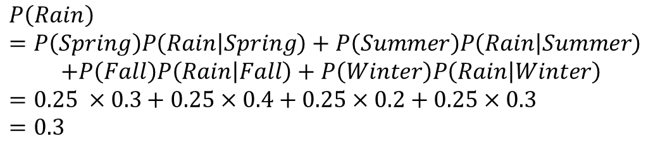
Data classification – Naïve Bayes
Example :
Calculate the probability of rain in the year
 | Spring | Summer | Fall | Winter
Sunny | 0.7 | 0.6 | 0.8 | 0.7
Rain | 0.3 | 0.4 | 0.2 | 0.3
$$P\left(Rain\right)$$
$$=P\left(Spring\right)P\left(Rain | Spring\right)+P\left(Summer\right)P\left(Rain | Summer\right)$$
$$+P\left(Fall\right)P\left(Rain | Fall\right)+P\left(Winter\right)P\left(Rain | Winter\right)$$
$$=0.25 ×0.3+0.25×0.4+0.25×0.2+0.25×0.3$$
$$=0.3$$
$$P\left(A\right)=P\left[\left(A∩H_{1}\right)∪\left(A∩H_{2}\right)∪\left(A∩H_{3}\right)∪…∪\left(A∩H_{n}\right)\right]$$
$$=P\left(A∩H_{1}\right)+P\left(A∩H_{2}\right)+P\left(A∩H_{3}\right)+…+P\left(A∩H_{n}\right)$$
$=P\left(H_{1}\right)P\left(A | H_{1}\right)+P\left(H_{2}\right)P\left(A | H_{2}\right)$+$P\left(H_{3}\right)P\left(A | H_{3}\right)$+…+$P\left(H_{n}\right)P\left(A | H_{n}\right)$
$$=\sum_{i=1}^{n}{P\left(H_{i}\right)P\left(A | H_{i}\right)}$$

Slide 33
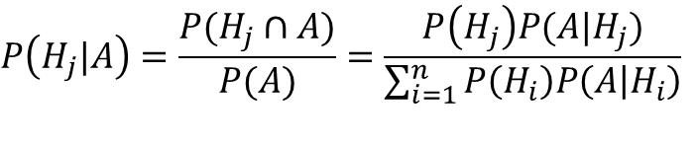
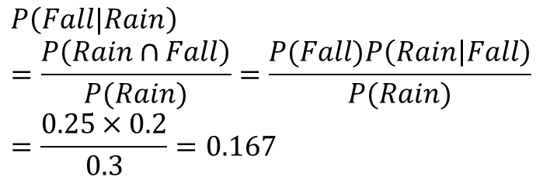
Data classification – Naïve Bayes
Example :
If the day rains, what is the probability that it rains in fall?
 | Spring | Summer | Fall | Winter
Sunny | 0.7 | 0.6 | 0.8 | 0.7
Rain | 0.3 | 0.4 | 0.2 | 0.3
$$P\left(Fall|Rain\right)$$
$$=\frac{P\left(Rain∩Fall\right)}{P(Rain)}=\frac{P(Fall)P\left(Rain | Fall\right)}{P(Rain)}$$
$$=\frac{0.25×0.2}{0.3}=0.167$$
$$P\left(H_{j}|A\right)=\frac{P(H_{j}∩A)}{P(A)}=\frac{P\left(H_{j}\right)P(A|H_{j})}{\sum_{i=1}^{n}{P\left(H_{i}\right)P\left(A | H_{i}\right)}}$$

Slide 34
Data classification – Naïve Bayes
Naïve Bayes
Assumptions
Features are independence to each other
All features are useful

Slide 35
Data classification – Naïve Bayes
Day | Outlook | Temperature | Humidity | Wind | PlayTennis
D1 | Sunny | Hot | High | Weak | No
D2 | Sunny | Hot | High | Strong | No
D3 | Overcast | Hot | High | Weak | Yes
D4 | Rain | Mild | High | Weak | Yes
D5 | Rain | Cool | Normal | Weak | Yes
D6 | Rain | Cool | Normal | Strong | No
D7 | Overcast | Cool | Normal | Strong | Yes
D8 | Sunny | Mild | High | Weak | No
D9 | Sunny | Cool | Normal | Weak | Yes
D10 | Rain | Mild | Normal | Weak | Yes
D11 | Sunny | Mild | Normal | Strong | Yes
D12 | Overcast | Mild | High | Strong | Yes
D13 | Overcast | Hot | Normal | Weak | Yes
D14 | Rain | Mild | High | Strong | No
 | Outlook
 | Sunny | Overcast | Rain
Yes | 2 | 4 | 3
No | 3 | 0 | 2
Yes | 2/9 | 4/9 | 3/9
No | 3/5 | 0/5 | 2/5
 | Temperature
 | Hot | Mild | Cool
Yes | 2 | 4 | 3
No | 2 | 2 | 1
Yes | 2/9 | 4/9 | 3/9
No | 2/5 | 2/5 | 1/5
+
+
 | Humidity
 | High | Normal
Yes | 3 | 6
No | 4 | 1
Yes | 3/9 | 6/9
No | 4/5 | 1/5
 | Wind
 | Strong | Weak
Yes | 3 | 6
No | 3 | 2
Yes | 3/9 | 6/9
No | 3/5 | 2/5
P(Hot|Yes)

Slide 36
Data classification – Naïve Bayes
Assumptions
Outlook = H1
Temperature = H2
Humidity = H3
Wind = H4
PlayTennis=A
Features are independence to each other

Slide 37
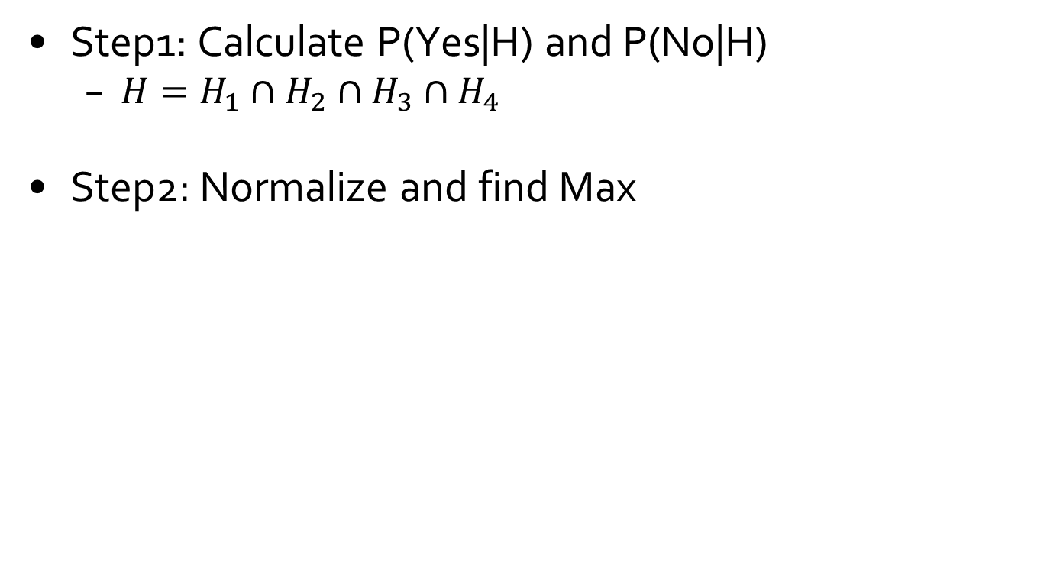
Data classification – Naïve Bayes
Step1: Calculate P(Yes|H) and P(No|H)
$H=H_{1}∩H_{2}∩H_{3}∩H_{4}$
Step2: Normalize and find Max

Slide 38
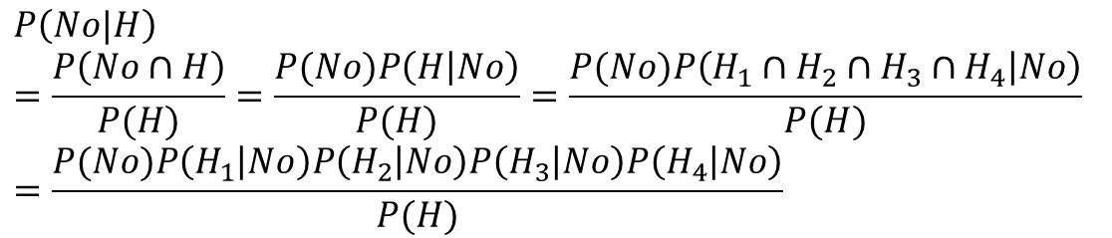
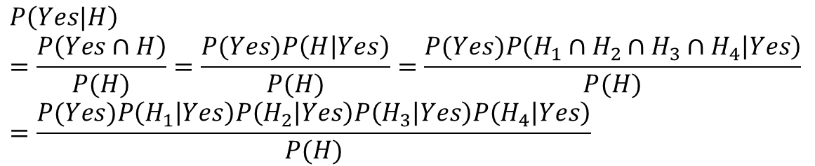
Data classification – Naïve Bayes
$$P\left(Yes|H\right)$$
$$=\frac{P\left(Yes∩H\right)}{P(H)}=\frac{P(Yes)P\left(H | Yes\right)}{P(H)}=\frac{P(Yes)P\left(H_{1}∩H_{2}∩H_{3}∩H_{4} | Yes\right)}{P(H)}$$
$$=\frac{P(Yes)P\left(H_{1} | Yes\right)P\left(H_{2} | Yes\right)P\left(H_{3} | Yes\right)P\left(H_{4} | Yes\right)}{P(H)}$$
$$P\left(No|H\right)$$
$$=\frac{P\left(No∩H\right)}{P(H)}=\frac{P(No)P\left(H | No\right)}{P(H)}=\frac{P(No)P\left(H_{1}∩H_{2}∩H_{3}∩H_{4} | No\right)}{P(H)}$$
$$=\frac{P(No)P\left(H_{1} | No\right)P\left(H_{2} | No\right)P\left(H_{3} | No\right)P\left(H_{4} | No\right)}{P(H)}$$

Slide 39

Data classification – Naïve Bayes
Example :
{H1 = Sunny, H2 = Cool, H3 = High, H4 = Strong}
PlayTennis = Yes or No?
Step 1:
$$P\left(Yes|H\right)$$
$$=\frac{P\left(Yes∩H\right)}{P(H)}=\frac{P(Yes)P\left(H | Yes\right)}{P(H)}=\frac{P(Yes)P\left(H_{1}∩H_{2}∩H_{3}∩H_{4} | Yes\right)}{P(H)}$$
$$=\frac{P(Yes)P\left(H_{1} | Yes\right)P\left(H_{2} | Yes\right)P\left(H_{3} | Yes\right)P\left(H_{4} | Yes\right)}{P(H)}$$
$$=\frac{P(Yes)P\left(Sunny | Yes\right)P\left(Cool | Yes\right)P\left(High | Yes\right)P\left(Strong | Yes\right)}{P(H)}$$
$$=\frac{\frac{9}{14}×\frac{2}{9}×\frac{3}{9}×\frac{3}{9}×\frac{3}{9}}{P(H)}$$

Slide 40

Data classification – Naïve Bayes
Example :
{H1 = Sunny, H2 = Cool, H3 = High, H4 = Strong}
Step 1:
$$P\left(No|H\right)$$
$$=\frac{P\left(No∩H\right)}{P(H)}=\frac{P(No)P\left(H | No\right)}{P(H)}=\frac{P(No)P\left(H_{1}∩H_{2}∩H_{3}∩H_{4} | No\right)}{P(H)}$$
$$=\frac{P(No)P\left(H_{1} | No\right)P\left(H_{2} | No\right)P\left(H_{3} | No\right)P\left(H_{4} | No\right)}{P(H)}$$
$$=\frac{P(No)P\left(Sunny | No\right)P\left(Cool | No\right)P\left(High | No\right)P\left(Strong | No\right)}{P(H)}$$
$$=\frac{\frac{5}{14}×\frac{3}{5}×\frac{1}{5}×\frac{4}{5}×\frac{3}{5}}{P(H)}$$

Slide 41

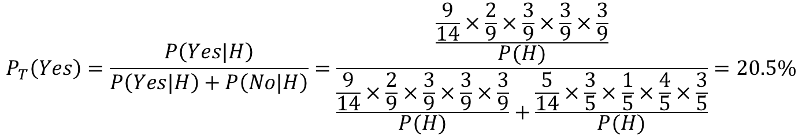
Data classification – Naïve Bayes
Example :
{H1 = Sunny, H2 = Cool, H3 = High, H4 = Strong}
Step 2: Normalize and find Max
$$P_{T}\left(Yes\right)=\frac{P\left(Yes|H\right)}{P\left(Yes|H\right)+P\left(No|H\right)}=\frac{\frac{\frac{9}{14}×\frac{2}{9}×\frac{3}{9}×\frac{3}{9}×\frac{3}{9}}{P(H)}}{\frac{\frac{9}{14}×\frac{2}{9}×\frac{3}{9}×\frac{3}{9}×\frac{3}{9}}{P(H)}+\frac{\frac{5}{14}×\frac{3}{5}×\frac{1}{5}×\frac{4}{5}×\frac{3}{5}}{P(H)}}=20.5\%$$
$$P_{T}\left(No\right)=\frac{P\left(No|H\right)}{P\left(Yes|H\right)+P\left(No|H\right)}=1−P_{T}\left(Yes\right)=79.5\%$$
PlayTennis = No

Slide 42
Exercise
{H1 = Overcast, H2 = Hot, H3 =High , H4 = Strong}
PlayTennis=Yes or No?
 | Outlook
 | Sunny | Overcast | Rain
Yes | 2 | 4 | 3
No | 3 | 0 | 2
Yes | 2/9 | 4/9 | 3/9
No | 3/5 | 0/5 | 2/5
 | Humidity
 | High | Normal
Yes | 3 | 6
No | 4 | 1
Yes | 3/9 | 6/9
No | 4/5 | 1/5
 | Temperature
 | Hot | Mild | Cool
Yes | 2 | 4 | 3
No | 2 | 2 | 1
Yes | 2/9 | 4/9 | 3/9
No | 2/5 | 2/5 | 1/5
 | Wind
 | Strong | Weak
Yes | 3 | 6
No | 3 | 2
Yes | 3/9 | 6/9
No | 3/5 | 2/5

Slide 43
Exercise
{H1 = Rain, H2 = Cool, H3 = Normal, H4 = Strong}
PlayTennis=Yes or No?
 | Outlook
 | Sunny | Overcast | Rain
Yes | 2 | 4 | 3
No | 3 | 0 | 2
Yes | 2/9 | 4/9 | 3/9
No | 3/5 | 0/5 | 2/5
 | Humidity
 | High | Normal
Yes | 3 | 6
No | 4 | 1
Yes | 3/9 | 6/9
No | 4/5 | 1/5
 | Temperature
 | Hot | Mild | Cool
Yes | 2 | 4 | 3
No | 2 | 2 | 1
Yes | 2/9 | 4/9 | 3/9
No | 2/5 | 2/5 | 1/5
 | Wind
 | Strong | Weak
Yes | 3 | 6
No | 3 | 2
Yes | 3/9 | 6/9
No | 3/5 | 2/5

Slide 44
Data classification – Naïve Bayes
> library(e1071)
> set.seed(2)
> n=0.1*nrow(iris)
> test.index=sample(1:nrow(iris),n)
> iris.train=iris[-test.index,]
> iris.test=iris[test.index,]
> iris.nB=naiveBayes(Species~.,data=iris.train)
> nB.pred=predict(iris.nB,newdata=iris.test)
> nB.pred
> mean(nB.pred==iris.test[,5])

Slide 45
Data classification – Naïve Bayes
> library(e1071)
> library(ISLR)
> high = ifelse (Carseats$Sales >=8,"YES","NO")
> x=cbind(Carseats,high)
> x$Education = as.factor(x$Education)
> y=x[,-1]
> set.seed(2) #set random seed
> train =sample(1:nrow(y),nrow(y)/2) #training data index
> test = -train #testing data index
> train_data=y[train,]
> test_data=y[test,]
> test_high=high[test] #answer
> nB_model= naiveBayes(high~.,data=train_data) #build model
> nB.predict=predict(nB_model,test_data,type="class")
> nB.predict
> mean(nB.predict==test_high)

Slide 46
Exercise
Dataset
train=read.table("train_data.csv", header=T, sep=",")
test=read.table("test_data.csv", header=T, sep=",")
ctrain=scan("ctrain.txt",what=character())
ctest=scan("ctest.txt",what=character())
Develop a Naïve Bayes model to predict whether the patient is sick or not.
Calculate the TP, FP, TN and FN
Calculate the accuracy, sensitivity, specificity and precision

Slide 47
Data classification – SVM

Slide 48
Data classification – SVM
SVM (Support Vector Machines)
A SVM model is a representation of the examples as points in space, mapped so that the examples of the separate categories are divided by a clear gap that is as wide as possible.
New examples are then mapped into that same space and predicted to belong to a category based on which side of the gap they fall on.

Slide 49
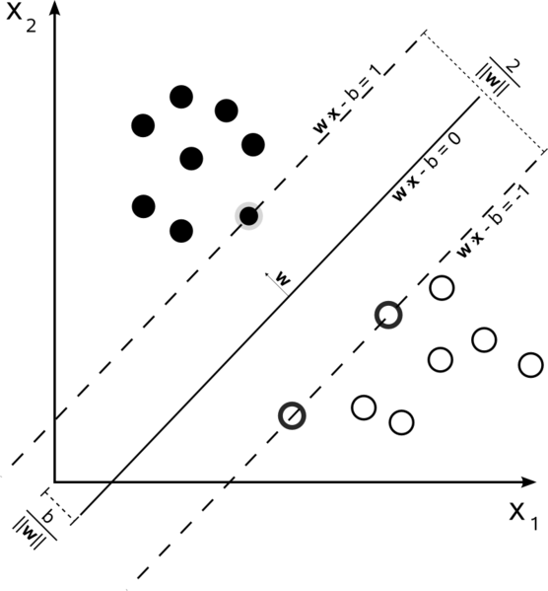



Data classification – SVM
SVM (Support Vector Machines)
Linear SVM
Goal : To Find the maximum marginal hyperplane
D
$$\overset{⃑}{v}$$
$$Let \overset{⃑}{v}=\left[\begin{matrix}a \\ b\end{matrix}\right] \overset{⃑}{x}=\left[\begin{matrix}x \\ y\end{matrix}\right]$$
$$ax+by+c=0$$
$$↔\overset{⃑}{v}∙\overset{⃑}{x}+c=0$$
$$D=\frac{\left|ax_{0}+by_{0}+c\right|}{\sqrt{a^{2}+b^{2}}}=\frac{{\overset{⃑}{v}}^{T}∙\overset{⃑}{x}+c}{\left|\overset{⃑}{v}\right|}$$

Slide 50
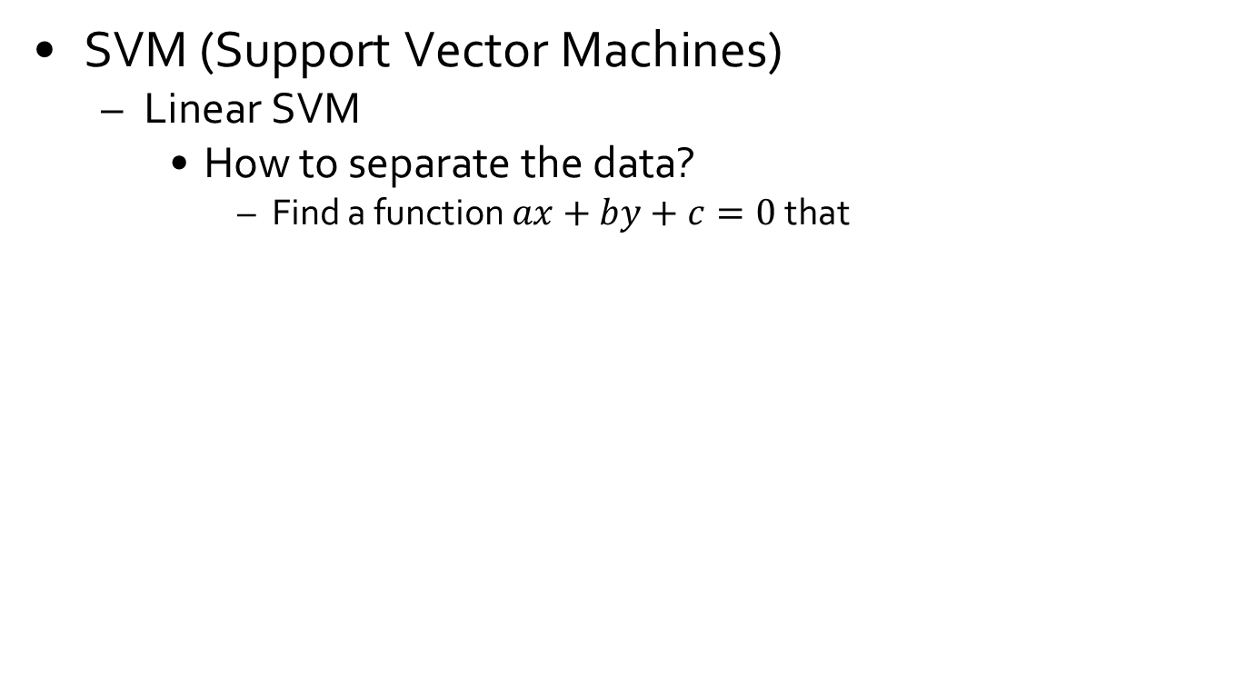


Data classification – SVM
SVM (Support Vector Machines)
Linear SVM
How to separate the data?
Find a function $ax+by+c=0$that
$$ax_{0}+by_{0}+c≥0$$
$$ax_{0}+by_{0}+c<0$$

Slide 51
Data classification – SVM
SVM (Support Vector Machines)
Linear SVM
Which line is the best?
Choose the one with large margin
L1
L2
L3

Slide 52
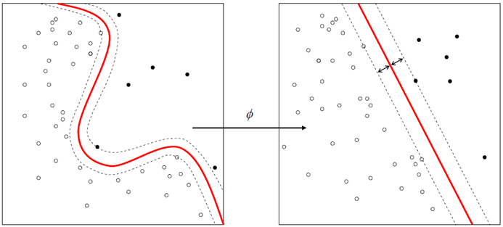
Data classification – SVM
SVM (Support Vector Machines)
Nonlinear classification
Every dot product is replaced by a nonlinear kernel function
Gaussian radial basis function(RBF)

Slide 53
Data classification – SVM
SVM type
C-support vector classification (C-SVC)
Parameter :cost gamma
nu- support vector classification (nu-SVC)
Parameter :cost gamma nu
distribution estimation (one-class SVM)
Parameter :cost gamma nu
epsilon-support vector regression (epsilon-SVR)
Parameter :cost gamma epsilon
nu-support vector regression (SVR)
Parameter :cost gamma nu
Ref : CHIH-CHUNG CHANG and CHIH-JEN LIN, "LIBSVM: A Library for Support Vector Machines"

Slide 54

Data classification – SVM
SVM (Support Vector Machines)
http://www.csie.ntu.edu.tw/~cjlin/libsvm/index.html#GUI

Slide 55
Data classification – SVM
> install.packages("e1071")
> library(e1071)
> set.seed(2)
> n=0.1*nrow(iris)
> test.index=sample(1:nrow(iris),n)
> iris.train=iris[-test.index,]
> iris.test=iris[test.index,]
> bestgc=tune.svm(iris.train[,1:4],iris.train[,5] ,
+ gamma = 2^(-15:3),cost = 2^(-5:15),scale=F)#tune cost and gamma
> bestg=bestgc[[1]][[1]] #best gamma
> bestc=bestgc[[1]][[2]] #best cost
> bbmodel=svm(iris.train[,1:4],iris.train[,5],
+ gamma=bestg,cost=bestc,scale=F) #build model
> svm.result=predict(bbmodel, iris.test[,1:4], scale=F) #predict
> mean(svm.result==iris.test[,5])

Slide 56
Exercise
Dataset
train=read.table("train_data.csv", header=T, sep=",")
test=read.table("test_data.csv", header=T, sep=",")
ctrain=scan("ctrain.txt",what=character())
ctest=scan("ctest.txt",what=character())
Develop a SVM model to predict whether the patient is sick or not.
Calculate the TP, FP, TN and FN
Calculate the accuracy, sensitivity, specificity and precision

Slide 57
Conclusion

Slide 58
Workflow
Raw Data
Data Preprocessing
Feature
Selection
Machine
Learning
Evaluation & Interpretation
Missing Value
Filter Outliers
Merge Table
…
Decision Tree
Correlation
…
KNN
Decision Tree
Random Forest
Naïve Bayes
SVM
…
Sensitivity
Specificity
Precision
Accuracy
ROC curve
…

Slide 59
Q&A

